Slide 1
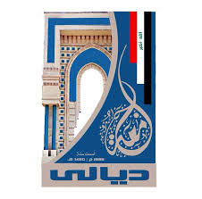
Electrical Circuit-I
3rd Lecture

